Slide 1
Healthcare Data Analysis
VEKARIYA URVISH BHAVINBHAI
KAKADIYA KRUNAL GORDHANBHAI
DINESHGOPI SUNKARA
BHOOKYA GOPI KRISHNA

Slide 2
Abstract
This project explores a healthcare dataset to identify trends and insights aimed at enhancing patient care and outcomes.
Key data analysis tools, including Pandas for data handling and Seaborn for visualization, were used to examine patient demographics, medical conditions, and treatment results.
The main objective was to reveal patterns and correlations to support healthcare providers in making informed, data-driven decisions.
Findings offer a foundational understanding of factors impacting patient care, setting the stage for future predictive studies in healthcare.

Slide 3
Introduction
The healthcare industry creates a lot of data, and analyzing it can help improve patient care and health outcomes.
This project looks at a healthcare dataset with information on patients, their conditions, and treatments.
By analyzing and visualizing this data, we aim to find patterns that can help healthcare providers make informed decisions.
These insights can help doctors and healthcare teams understand patient needs better, improve treatment plans, and predict possible outcomes, making healthcare more effective.
This work also sets the groundwork for future research, such as using predictive models to provide more personalized care for patients.

Slide 4
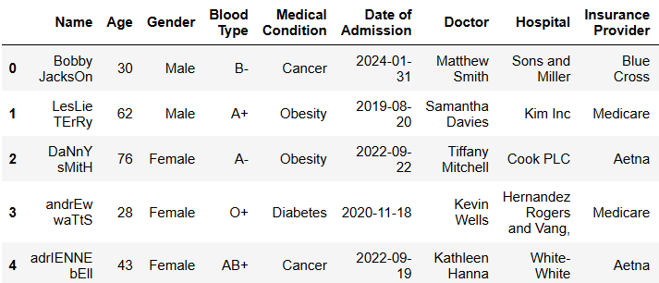
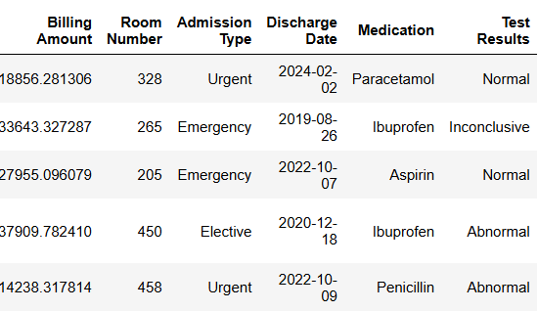
Dataset

Slide 5
Preprocessing
Data Loading:
The healthcare dataset was imported using Python’s Pandas library, allowing for efficient data handling and exploration.
Data Inspection:
Used info() to check for missing values and verify data types across columns.
describe() was used to generate summary statistics, giving insights into the distribution of numerical data like age, treatment duration, or other relevant metrics.
Data Cleaning:
Checked for and handled missing values where necessary to ensure the dataset was complete and reliable for analysis.
Examined for any duplicates or inconsistencies in data entries to maintain data quality.
Data Transformation:
Converted categorical data to numerical values (if needed) to enable analysis.
Applied normalization or scaling to certain features to ensure consistent data ranges, facilitating better visualization and model training in future steps.

Slide 6
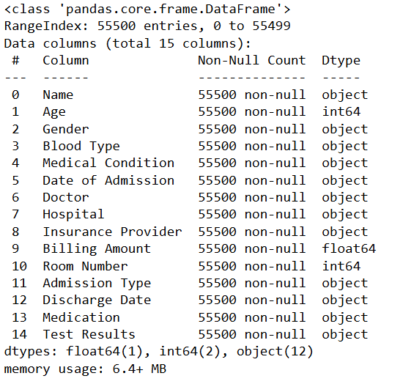
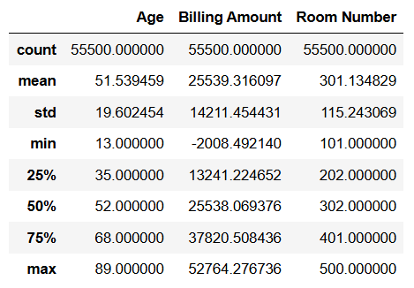
Data Distribution & Statistics

Slide 7
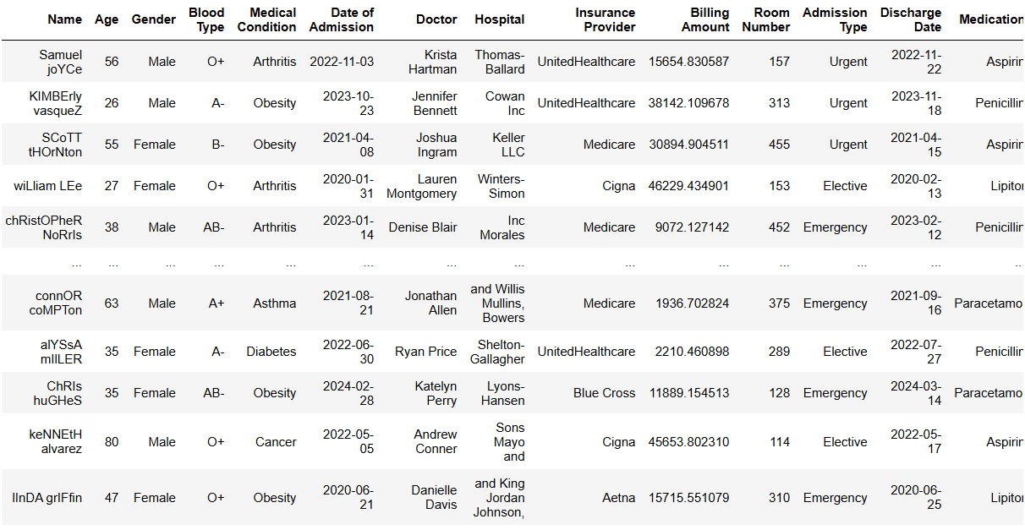
Duplicate Value

Slide 8
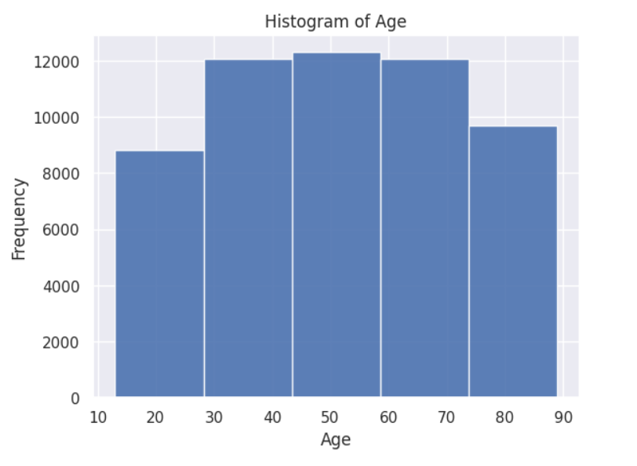
Visual Analysis
Number of patient by Age
A histogram is used to visualize the distribution of the Age variable in the dataset. It shows how the ages are distributed across different ranges.
The histogram is divided into 5 bins to group the ages and show the frequency of occurrences within each age range.
Opacity (alpha = 0.9) ensures that the bars are clearly visible, and gridlines are added for better readability.
The plot helps identify the age distribution within the dataset, showing trends such as the concentration of patients in certain age groups or possible outliers.

Slide 9
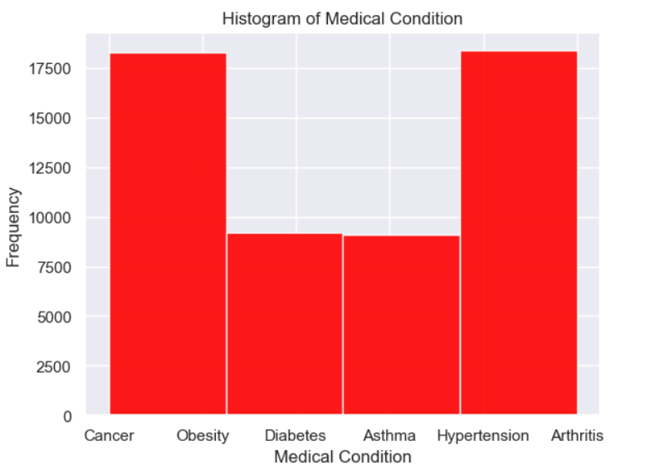
Medical Condition
A histogram is created to show the distribution of the Medical Condition variable. Each bar represents the frequency of a particular condition within the dataset.
The histogram is divided into 4 bins (categories of medical conditions) to group the data. The bars have an opacity of 0.9 and are colored red.
The plot provides insights into the frequency distribution of different medical conditions, helping to identify the most common conditions in the dataset.

Slide 10
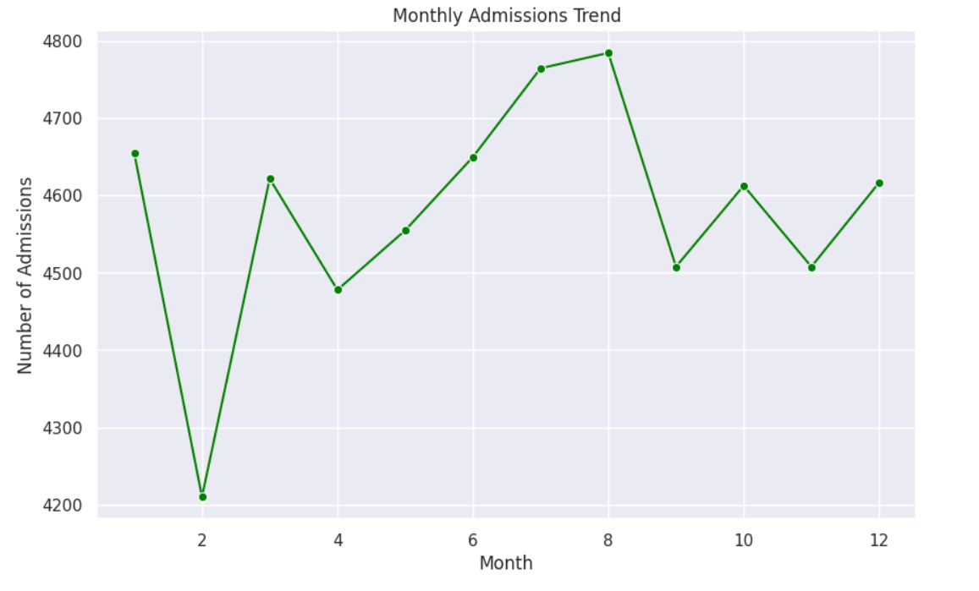
Monthly Admission Trend
Converted 'Date of Admission' to datetime format and extracted the month for each admission. The total number of admissions per month was calculated using value_counts().
A line plot was created to visualize the number of admissions per month, revealing seasonal trends and fluctuations across the year.
The plot helps identify peak months with higher admissions, indicating potential seasonal patterns in hospital activity (e.g., during flu season).

Slide 11
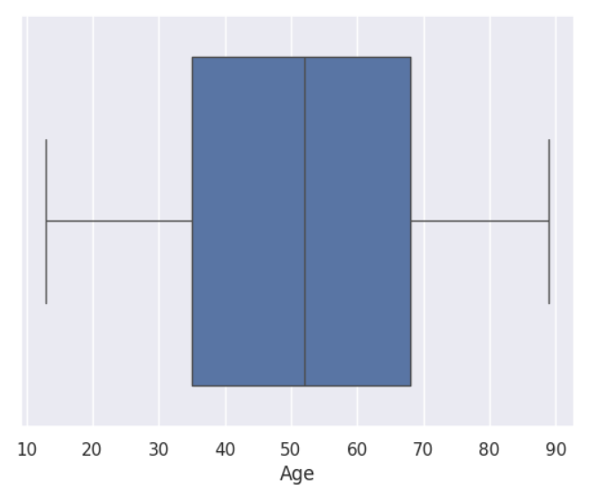
Monthly Admission Trend
A boxplot is created to visualize the distribution of the Age variable in the healthcare dataset, providing a summary of its spread, central tendency, and potential outliers.
The box shows the interquartile range (IQR), with the median (middle value) represented by a line inside the box.
The whiskers extend to show the range of ages, while outliers (if any) are displayed as individual points outside the whiskers.
The boxplot helps identify outliers in the age data and gives a visual representation of the age distribution, showing where most patients' ages lie and how spread out the data is.

Slide 12
Conclusion
This project involved analyzing healthcare data to uncover key insights into patient demographics and hospital trends. By exploring variables such as Age, Medical Condition, and Admission Trends, we gained a deeper understanding of the patterns within the dataset.
Visualizations, such as the Monthly Admissions Trend and Histograms of Age and Medical Condition, highlighted seasonal fluctuations in hospital admissions and the distribution of patient characteristics.
These insights are valuable for healthcare providers to anticipate peak periods, optimize resource allocation, and improve patient care management.
The findings can be used to inform decision-making and contribute to more effective planning in healthcare operations.

Slide 13
Reference
https://www.kaggle.com/
https://www.kaggle.com/datasets/prasad22/healthcare-dataset

Slide 14
GitHub Repository
https://github.com/Urvish003/HealthcareAnalysis

Slide 15
Thank You

